Slide 1
GDP TRENDS ANALYSIS REPORT
PRESENTED BY LINDA WACHIRA

Slide 2
Project Background
Global economic performance varies widely across countries and regions, influenced by factors such as trade, industrialization, population growth, and political stability. Understanding GDP trends helps governments, organizations, and investors make informed decisions. However, regional comparisons and granular insights (e.g., subregion or country-level patterns) are often scattered across multiple datasets, making analysis difficult.

Slide 3
Problem Statement
There is limited consolidated analysis of GDP trends across continents, regions, and countries over extended periods. This project addresses this gap by exploring GDP metrics from 1995 to 2022 using UN economic data, with a focus on real GDP, nominal GDP, GDP per capita, and GDP growth rates to uncover key trends and disparities across different economic groupings.

Slide 4
Project Objective
General Objective
To analyze and visualize global and regional GDP trends from 1995–2022 to identify key economic patterns and provide insights for comparative and strategic understanding.
Specific Objectives
To compare real and nominal GDP across continents, regions, and countries.
To analyze GDP per capita variations and highlight disparities.
To assess growth rate trends over time, including major global events like the COVID-19 pandemic.
To identify top-performing countries and regions in GDP growth over the years.
To recommend potential areas for deeper economic investigation and forecasting.

Slide 5
Key Questions
How do GDP levels and growth rates vary across continents, regions, and countries?
Which regions lead in GDP per capita and which lag behind?
How did major events like the COVID-19 pandemic affect global GDP growth patterns?
What insights can inform future economic focus and policy direction?

Slide 6
Data Cleaning and Preparation
Collected UN GDP data spanning 1995–2022.
Standardized economic indicators (real GDP, nominal GDP, GDP per capita, growth rate).
Cleaned inconsistencies and handled missing values across regions and countries.
Modeled data relationships in MySQL and prepared tables for visualization in Power BI.

Slide 7
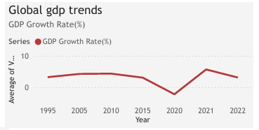
Analysis & Insights
The chart below show the global GDP growth rate between 1995-2022:

Slide 8
Global Overview
Asia leads in both real and nominal GDP with an average growth rate of 4.8%, driven by export-oriented economies like China and India.
Oceania records the highest GDP per capita, while Africa ranks lowest due to high population growth and low industrial diversification.

Slide 9
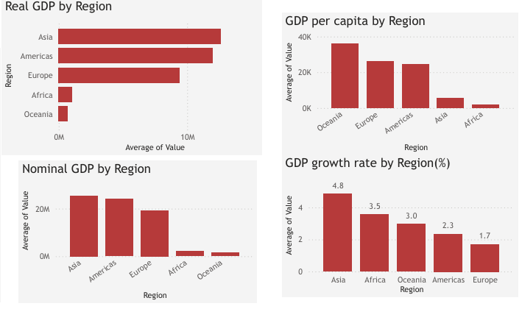
Global Overview Cont.

Slide 10
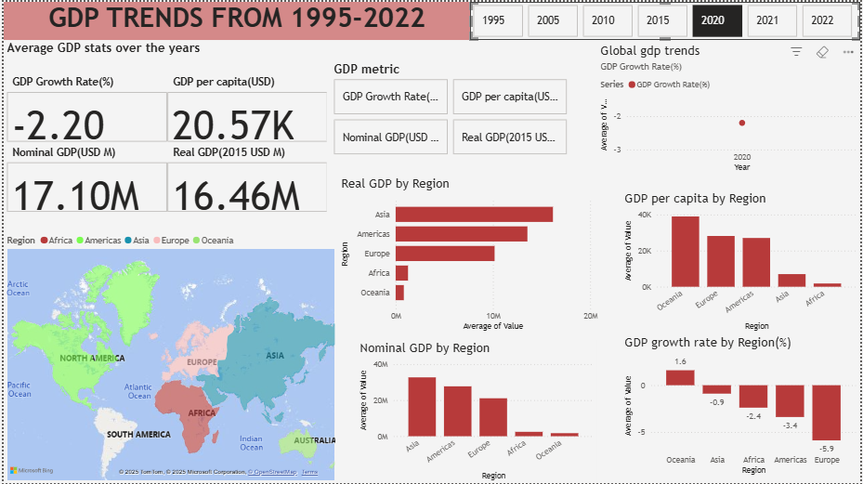
Global Overview Cont.
Global GDP growth dipped to -2.2% in 2020 during the pandemic but rebounded to 5.68% in 2021.

Slide 11
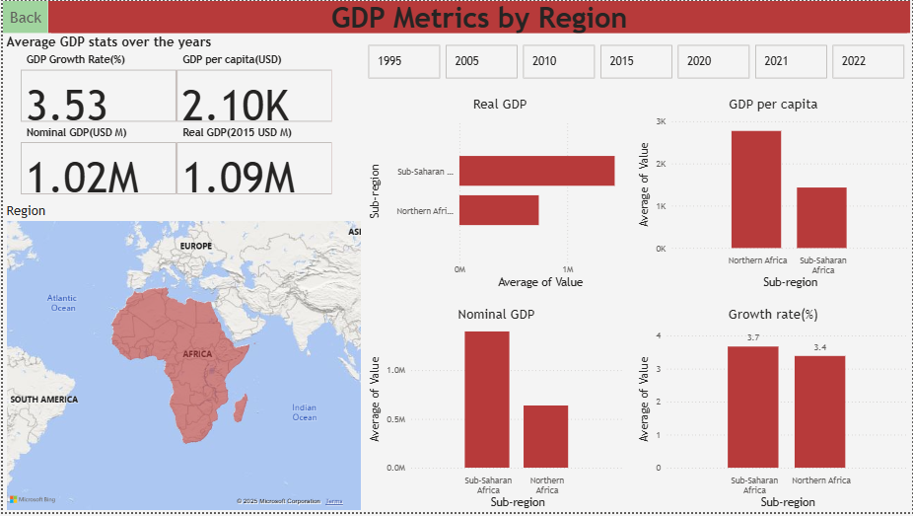
Regional Focus – Africa
Africa maintains a steady real GDP growth rate of 3.53%, second only to Asia.

Slide 12
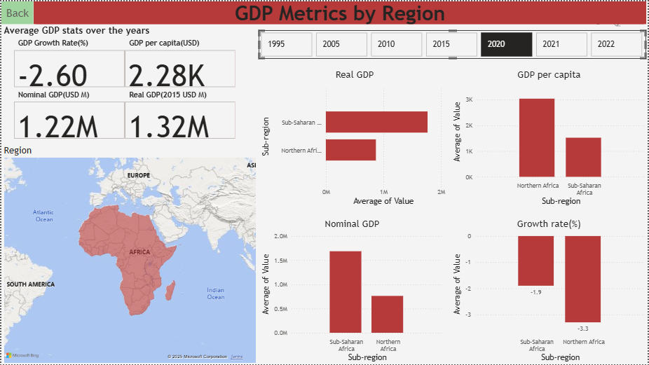
Regional Focus – Africa Cont.
It experienced a -2.6% growth rate in 2020, but recovered to 5.9% in 2021.

Slide 13
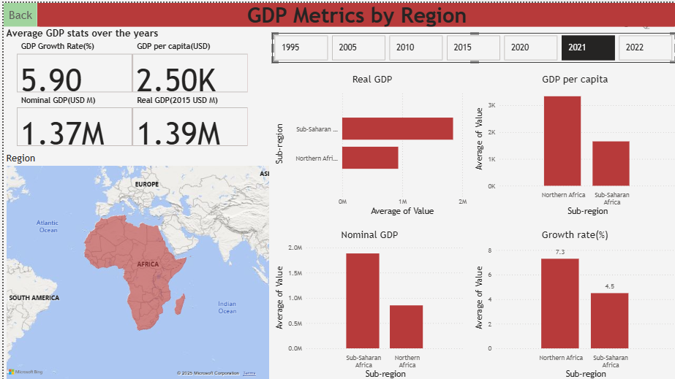
Regional Focus – Africa Cont.

Slide 14
Regional Focus – Africa Cont.
Sub-Saharan Africa slightly outpaces North Africa in long-term growth (3.6%), but North Africa leads in GDP per capita due to smaller populations and diversified economies.
In 2021, North Africa surpassed Sub-Saharan Africa by 2.8% growth, fueled by tourism rebound and political stability improvements.

Slide 15
Country-Level Highlights
Exceptional one-year growth performers include:
  Mali (1995 – 37.2%)
  Angola (2005 – 15%)
  Uganda (2010 – 19.9%)
  Somalia (2015 – 23.7%)
  Libya (2021 – 28.3% post-conflict recovery)
Nigeria leads in real GDP, while Seychelles tops in GDP per capita in 2022.

Slide 16
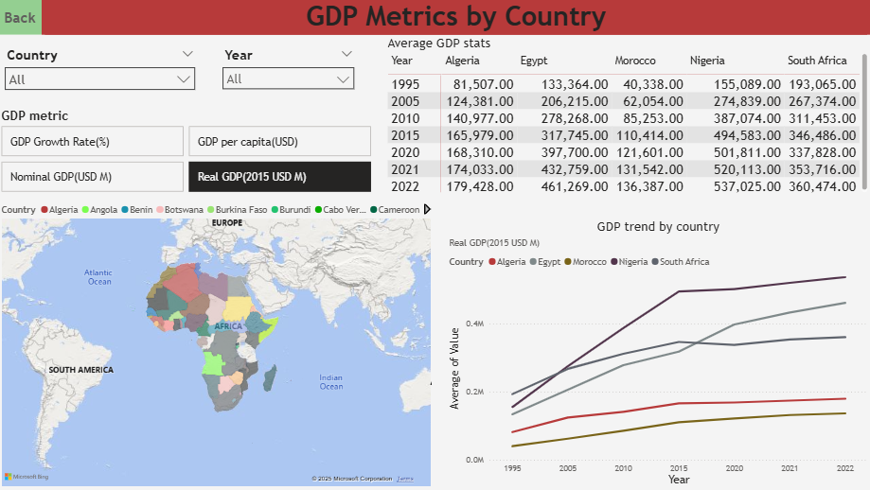
Country-Level Highlights Cont.

Slide 17
Recommendations
Focus on population-adjusted metrics (GDP per capita) for fairer cross-country comparisons.
Explore drivers behind Asia’s sustained growth (e.g., trade policy, industrialization) for replication in other regions.
Investigate factors behind Oceania’s high per-capita GDP to inform wealth distribution strategies.
Monitor Africa’s improving growth trajectory and explore sector diversification strategies (beyond agriculture).
Expand dataset to include inflation, population, and trade balance to enrich future forecasting and economic modeling.

Slide 18
Conclusion
This project provided a comprehensive overview of GDP trends from 1995–2022, highlighting regional disparities and shifts influenced by global events like the COVID-19 pandemic. Asia emerged as a growth leader, Oceania as the highest in per-capita wealth, and Africa as a region with promising but uneven growth trajectories. These insights form a foundation for deeper economic analysis, policy development, and future enhancements such as predictive modeling and integration of additional macroeconomic indicators.

